Slide 1

Issues and challengeS
ADVANCED DATA SCIENCE TRAINING
data-action-lab.com

Slide 2
OUTLINE
Bad Data
Overfitting
Big Data
Appropriateness and Transferability
Biases, Fallacy, Interpretation
Myths and Mistakes
The Future of D.S./A.I./M.L.
In Conclusion

Slide 3
LEARNING OBJECTIVES
Be able to describe, at a high level, some of the common issues and challenges associated with data analysis.
Understand the value of an approximate model.
Be familiar with the V5 description of big data.
Appreciate appropriate uses of data science results.
Awareness of some common types of bias in data science.
Awareness of some classic myths and mistakes in data science.

Slide 4
Bad Data
issuES AND CHALLENGES
“We all say we like data, but we don’t. We like getting insight out of data. That’s not quite the same as liking data itself. In fact, I dare say that I don’t quite care for data, and it sounds like I’m not alone.”
(Q.E. McCallum, Bad Data Handbook)

Slide 5
Bad Data
Does the dataset pass the smell test?
invalid entries, anomalous observations, etc.
Data formatted for human consumption, not machine readability
Difficulties with text processing
encoding
application-specific characters

Slide 6
Bad Data
Collecting data online
legality of obtaining data
storing offline versions
Detecting lies and mistakes
reporting errors (lies or mistakes)
use of polarizing language
Data and reality
bad data
bad reality?

Slide 7
Bad Data
Sources of bias and errors
imputation bias
top/bottom coding (replacing extreme values with average values)
proxy reporting (head of household for household)
Seeking perfection
academic data
professional data
government data
service data

Slide 8
Bad Data
Data science pitfalls
analysis without understanding
using only one tool (by choice or by fiat)
analysis for the sake of analysis
unrealistic expectations of data science
it’s on a need-to-know basis and you don’t need to know
Databases vs. files vs. cloud computing
the cloud will solve all of our problems!

Slide 9
Bad Data
When is close enough, good enough?
completeness
coherence
correctness
accountability

Slide 10
disCussion
As the saying goes, “garbage in, garbage out”. What are the business and public policy consequences of making decisions based on bad data?
Notes:
Intro to text analysis
We will be talking about data reduction using NHL game between Ottawa Senators vs. Toronto Maple Leafs on February 18th of 2017

Slide 11
Overfitting
ISSUES AND CHALLENGES
(Amar Gondaliya, Pingax)

Slide 12
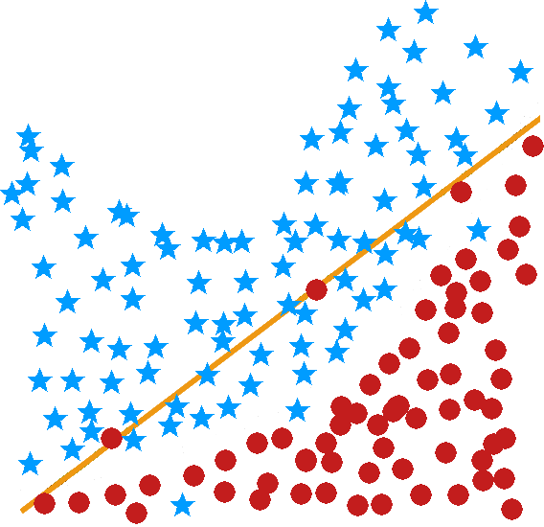
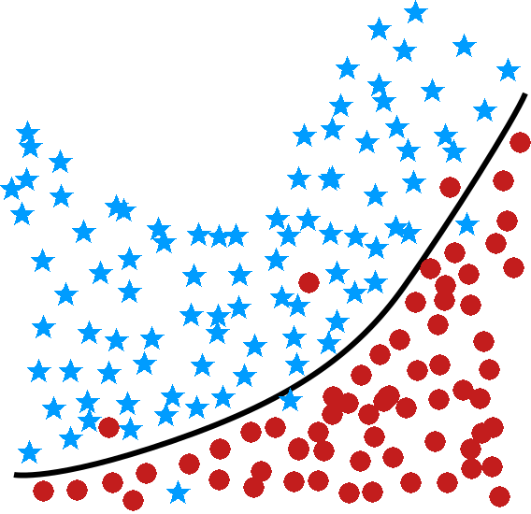
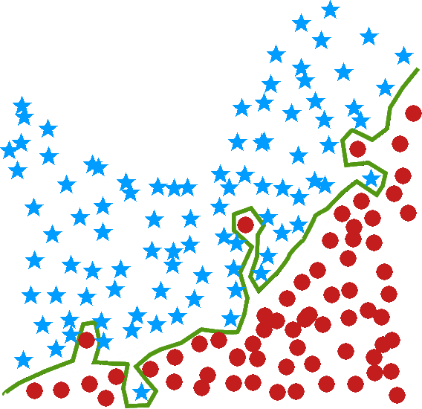
Goldilocks and the Three Models
underfit
just right
overfit

Slide 13
Fundamentals
The hope is for rules or models generated by any technique on a training set to be generalizable to new data (or validation/ testing sets).
Problems arise when knowledge that is gained from supervised learning does not generalize properly to the data.
Unsupervised learning can also be affected.
Ironically, this may occur if the rules or models fit the training set too well – the results are too specific to the training set.

Slide 14
Example
Rule I: based on a survey of 400 Germans, we infer that 43.75% of the world’s population has black hair, 37.5% have brown hair, 9% have blond hair, 0.25% have red hair, and 9.5% grey hair.
Rule II: humans’ hair colour is either black, brown, blond, red, or grey.
Rule III: approx. 40% of humans have black hair, 40% have brown hair, 5% blond, 2% red and 13% grey.

Slide 15
DISCUSSION
Which of the three rules is most useful? The most vague? Which is overly specific?
Notes:
Intro to text analysis
We will be talking about data reduction using NHL game between Ottawa Senators vs. Toronto Maple Leafs on February 18th of 2017

Slide 16
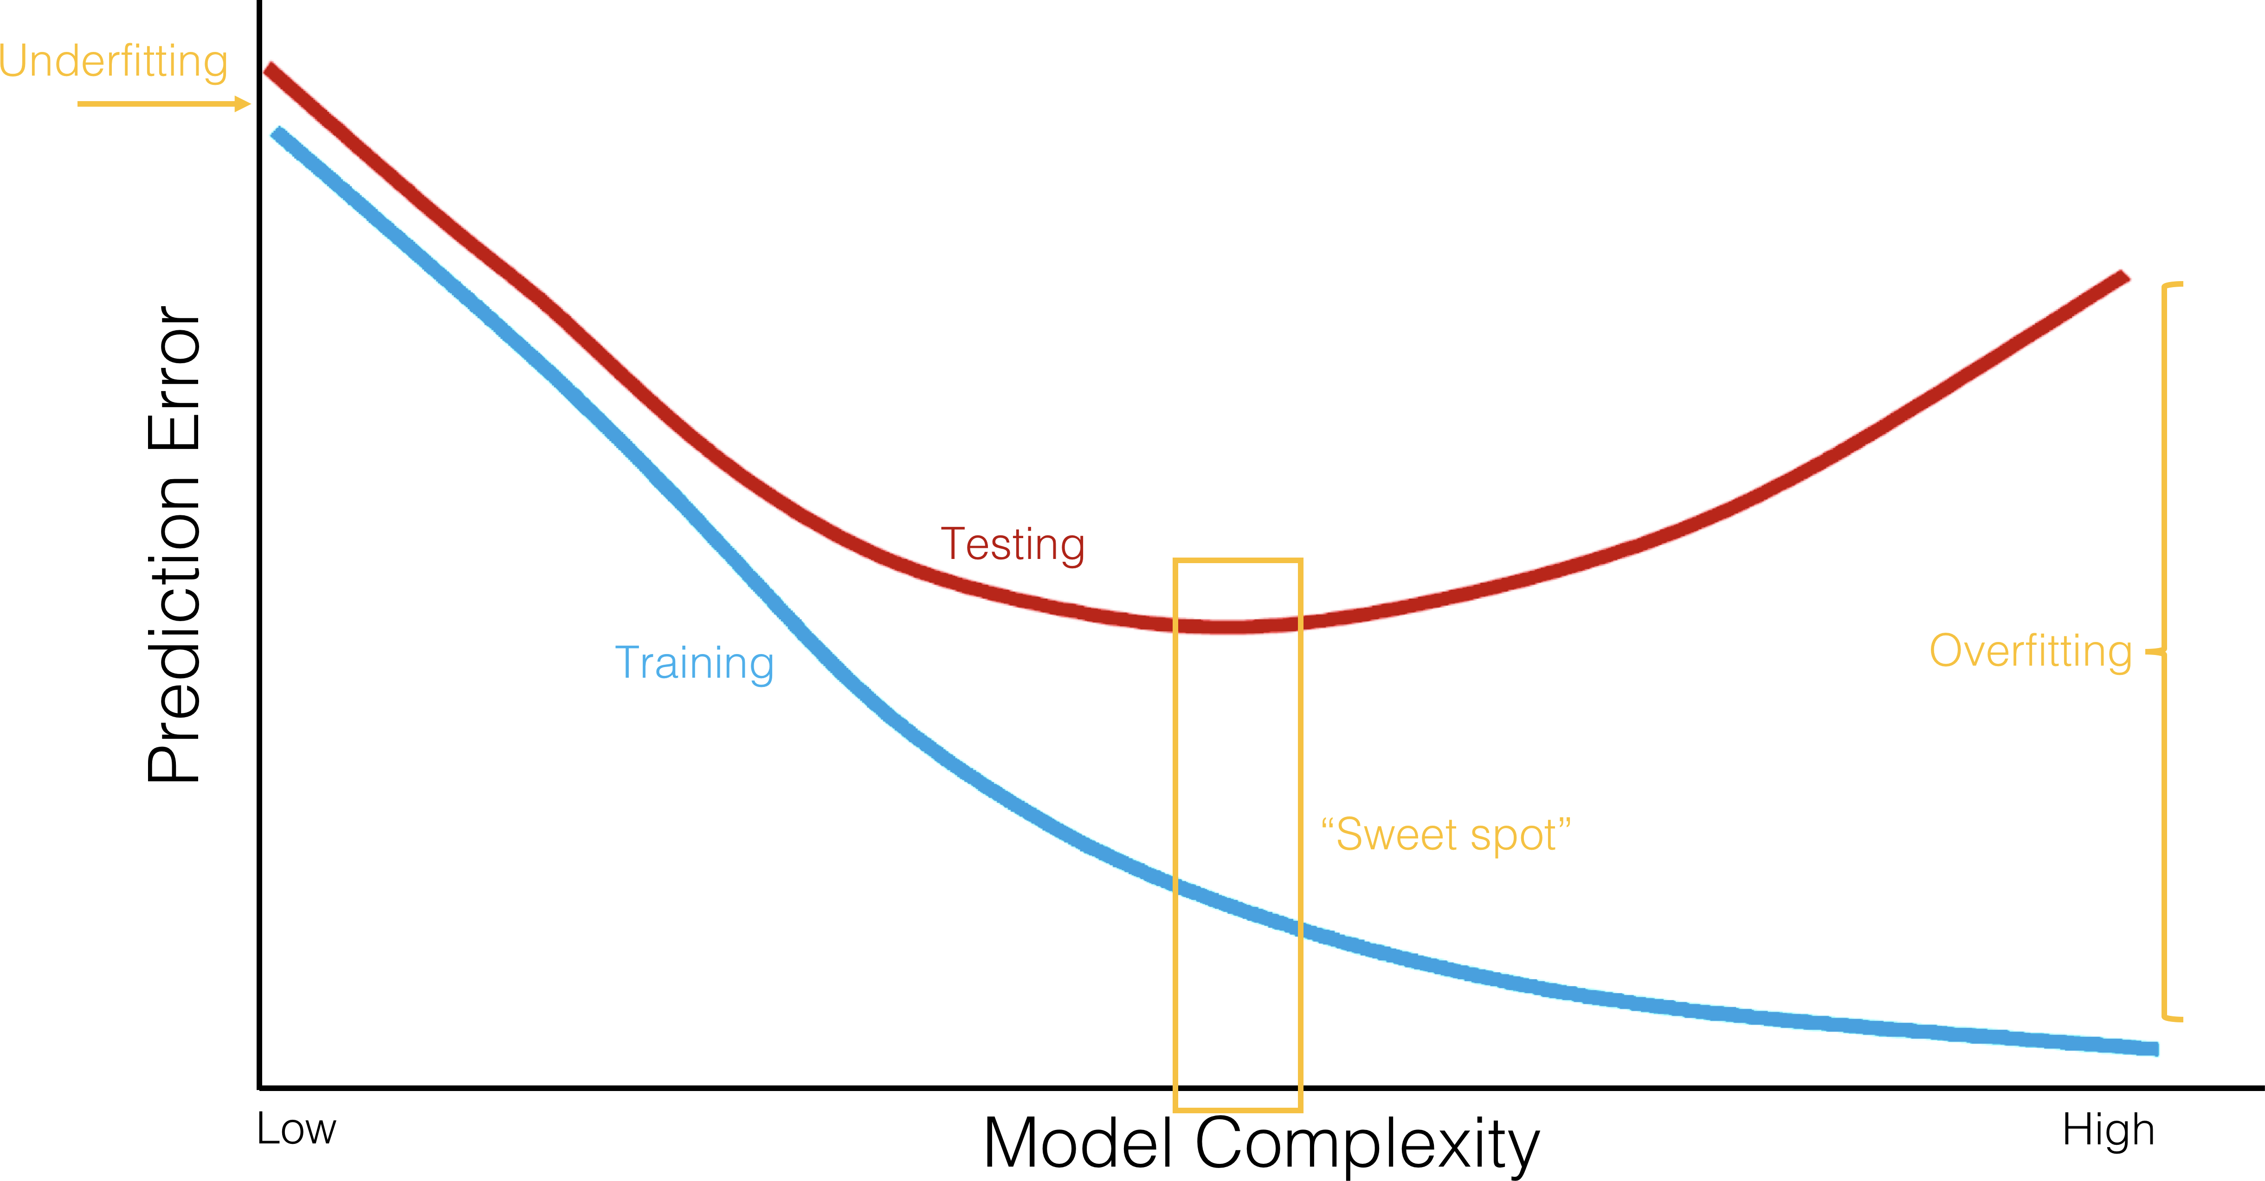

Slide 17
OVErFITTING
ALWAYS evaluate models on unseen (testing) data.

Slide 18
Possible Solutions
Overfitting can be overcome in several ways:
Using multiple training sets overlap is allowed (or not: see cross-validation)
Using larger training sets 70% - 30% split is suggested
Optimizing the data instead of the model models are only as good as the data

Slide 19
Recommended Procedures
[L.Torgo, Data Mining with R]
Small datasets (less than a few hundred observations)
use 100-200 repetitions of a bootstrap procedure
Average-sized datasets (less than a few thousand observations)
use a few repetitions of 10-fold cross-validation on the training set (see next slide)
Large datasets
use a few repetitions of holdout (70%-30%) split
________________________
Note: decision boundaries depend on computing power and number of tasks/workflows.

Slide 20
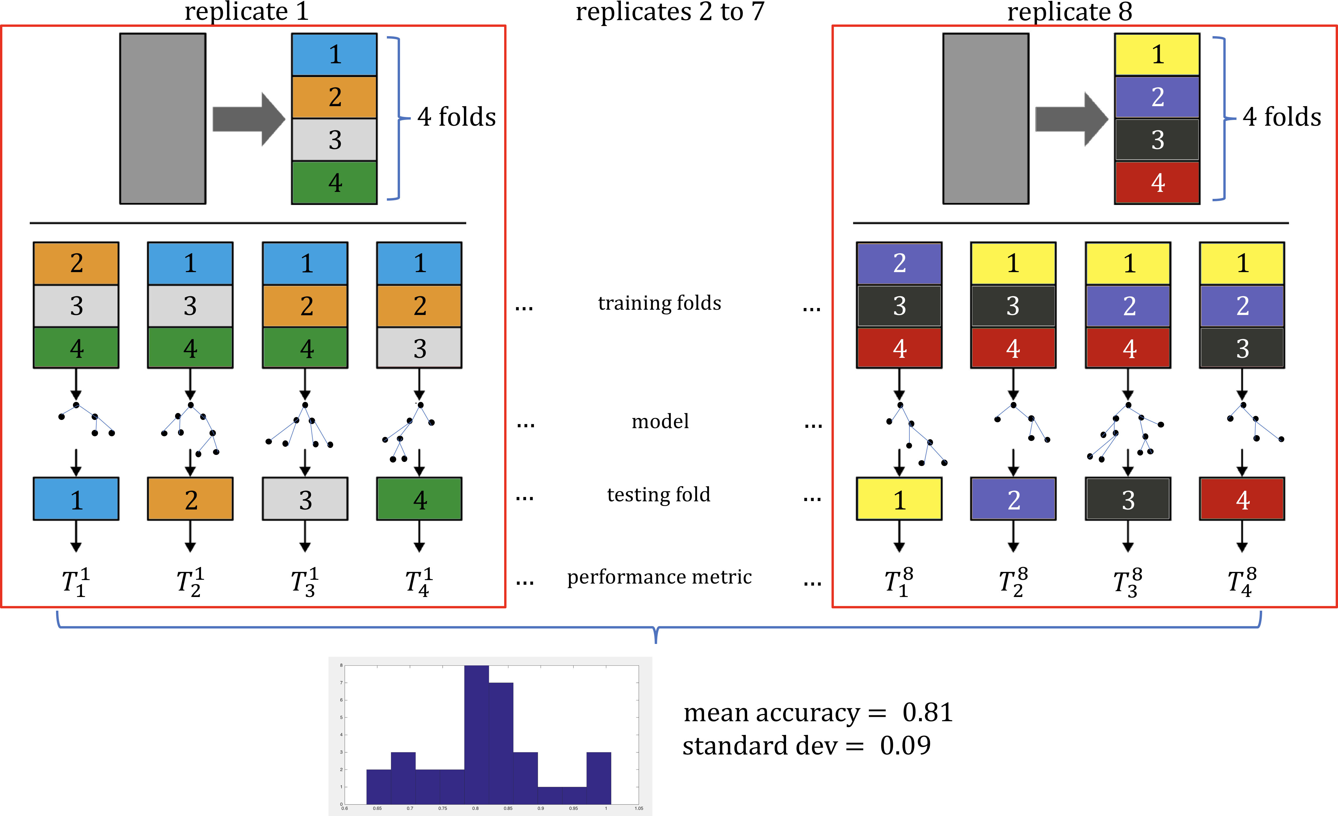

Slide 21
BIG Data
issuES AND CHALLENGES
“Data, big or small, is only as useful as the questions you ask of it.”
(Milo Jones and Philippe Silberzahn, Forbes Magazine)

Slide 22
A Word of Warning
Big Data is no crystal ball
“Past performance does not guarantee future results”
Big Data can't dictate personal or organizational values
The right value answer may be the wrong data science answer
Data-based conclusions do not live in a vacuum: context matters
Blind obedience to data-driven results is just as dangerous as rejection based on gut-reaction
Big Data can't solve every problem
“When all you have is a hammer, everything looks like a nail”

Slide 23
Big Data vs. Small Data
What is the main difference?
The datasets are LARGE
Issues: collection, capture, access, storage, analysis, visualization
Where does the data come from?
Technology advances are lifting the limits on data processing speeds
Information-sensing, mobile devices, cameras and wireless networks
What are the challenges?
Most techniques were built for very small dataset
Direct approach will leave the best analyst waiting years for results

Slide 24
The 5-V Paradigm
Volume: large amounts of data
Velocity: speed at which data is created, accessed, processed
Variety: different types of available data, can’t all be saved in relational databases (tables, pictures,…)
Veracity: quality and accuracy of big data is harder to control
Value: turn the data into something useful
Variability
Visualization

Slide 25
The Big Data Problem
Many computations happen instantly, others take a significant amount of time.
Crunching very large datasets is a perfect example. Analysis in R or Python with steadily increasing datasets leads to computer lags. Eventually, the time required becomes impractically long.
Optimizing code and using a faster CPU can only provide so much relief.
That is the Big Data problem.

Slide 26
Distributed Computing
Splitting the computations among multiple CPU cores/CPUs can divide the computation time by a factor of 4, or 32, or 1000. This allows algorithms to run on big data to keep analytics, smart services, and recommendations updated daily, hourly, in real time.
Election analogy to parallelization:
counting votes at different polling stations in a riding
each station simultaneously counts its own votes and reports their total
the totals of all polling stations are aggregated at Elections HQ
one person counting all the ballots would eventually get the same result, but it would take too long to get the result.

Slide 27












Analogy: Board Election
6752
230
198
228
…
230
112
75
9001
112
123
144
…
198
123
201
…
…
…
…
228
144
212
75
201
212
11793

Slide 28
Analogy: Pizzeria
The gains from parallelism depend on whether serial algorithms can be adapted to make use of parallel hardware.
Pizzeria analogy for limitations of parallelization/bottleneck:
multiple cooks can prepare toppings in parallel
but baking the crust can't be parallelized
doubling oven space will increase the number of pizzas that can be made simultaneously but won't substantially speed up any one pizza
sometimes bottlenecks prevent any gains from parallelism: people line up on both sides of a table to get some soup but there's only one ladle

Slide 29
Good News
Most practical computational tasks can be and are parallelized. Modern data scientists use frameworks where distributed computing are already implemented (Apache Spark implements MapReduce, for instance).

Slide 30
Appropriateness and Transferability
ISSUES AND CHALLENGES
“It can be tempting to use data as a crutch in decision-making: “The data says so!” But sometimes the data lets us down and that exciting correlation you found is just a by-product of a messy, biased sample. [...] Smart skeptics can help step back, reflect, and ask if what the data is saying actually fits with what you know and expect about the world.”
(Nicholas Diakopoulos, Harvard Business Review)

Slide 31
Appropriateness and Transferability
Data science models will be used heavily in the coming years (it has already started).
We have discussed pros and cons of some of the applications on ethical and other non-technical grounds, but there are also technical challenges.
Data Science methods are not appropriate if:
if you absolutely must use an existing (legacy) datasets instead of an ideal dataset (“it’s the best data we have!”)

Slide 32
Appropriateness and Transferability
Data Science methods are not appropriate if (continued):
the dataset has attributes that usefully predict a value of interest, but which are not available when a prediction is required
Example: the total time spent on a website may be predictive of a visitor’s future purchases, but the prediction must be made before the total time spent on the website is known…
if you will attempt to predict class membership using an unsupervised learning algorithm
Example: clustering loan default data might lead to a cluster contains many defaulters. If new instances get added to this cluster, should they be viewed as loan defaulters?

Slide 33
Non-Transferable Assumptions
Every model makes certain assumptions about what is and is not relevant to its workings, but there is a tendency to only gather data which is assumed to be relevant to a particular situation.
If data is used in other contexts, or to make predictions depending on attributes without data, validating the results is impossible.
Example: can we use a model that predicts mortgage defaulters to also predict car loan defaulters?

Slide 34
DISCUSSION
Is there truly no link between mortgage defaults and car loan defaults?
Notes:
Intro to text analysis
We will be talking about data reduction using NHL game between Ottawa Senators vs. Toronto Maple Leafs on February 18th of 2017

Slide 35
Biases, Fallacies, and Interpretation
Issues and CHallenges
“If two poll numbers differ by less than the margin of error, it’s not a news story. Scientific facts are not determined by public opinion polls. A poll taken of your viewers/internet users is not a scientific poll. What if all polls included the option “Don’t care”?”
(Jorge Chan, Piled Higher and Deeper)

Slide 36
Biases, Fallacies, and Interpretation
When consulting (or conducting) studies, you should try to determine how the following biases could have come into play:
Selection bias (what data was included, how was it selected?)
Omitted-variable bias (were relevant variables ignored?)
Detection bias (did prior knowledge affect the results?)
Funding bias (who’s paying for this?)
Publication bias (what’s not being published?)
Data-snooping bias (trying too hard?)
Analytical bias (did the choice of specific method affect the results?)
Exclusion bias (are specific observations/units being excluded?)

Slide 37
Biases, Fallacies, and Interpretation
Correlation is not causation (but it is a hint!)
Extreme patterns can mislead.
Stay within a study's range.
Keep the base rate in mind.
Odd results sometimes happen (Simpson's Paradox).

Slide 38
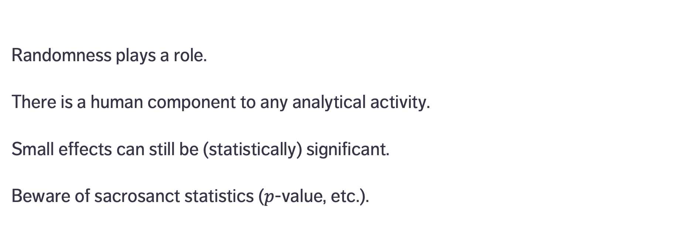
Biases, Fallacies, and Interpretation
Randomness plays a role.
There is a human component to any analytical activity.
Small effects can still be (statistically) significant.
Beware of sacrosanct statistics ($p$-value, etc.).

Slide 39
DISCUSSION
Does the presence of bias necessarily invalidate the results?
Notes:
Intro to text analysis
We will be talking about data reduction using NHL game between Ottawa Senators vs. Toronto Maple Leafs on February 18th of 2017

Slide 40
Myths and Mistakes
ISSUES AND CHALLENGES
“Nothing is always absolutely so.”
(Sturgeon’s First Law)
“95% of everything is crud.”
(Sturgeon’s Maxim)

Slide 41
Data Science Myths & Mistakes
[A.K. Maheshwari, Business Intelligence and Data Mining]
Myth #1 – Data science (DS) is about algorithms.
Myth #2 – DS is about predictive accuracy.
Myth #3 – DS requires a data warehouse.
Myth #4 – DS requires a large quantity of data.
Myth #5 – DS requires technical experts.

Slide 42
Data Science Myths & Mistakes
[A.K. Maheshwari, Business Intelligence and Data Mining]
Mistake #1 – Selecting the wrong problem.
Mistake #2 – Getting buried under tons of data without metadata understanding.
Mistake #3 – Not planning the data analysis process.
Mistake #4 – Insufficient business and domain knowledge.
Mistake #5 – Using incompatible data analysis tools.

Slide 43
Data Science Myths & Mistakes
[A.K. Maheshwari, Business Intelligence and Data Mining]
Mistake #6 – Using tools that are too specific.
Mistake #7 – Ignoring individual predictions/records in favour of aggregated results.
Mistake #8 – Running out of time.
Mistake #9 – Measuring results differently than the sponsor.
Mistake #10 – Naïvely believing what one’s told about the data.

Slide 44
DISCUSSION
Data science is about asking the right questions and accepting imaginative solutions.
In the battle between “tried, tested, and true” and “disruptive data science”, with whom do you side?
Notes:
Intro to text analysis
We will be talking about data reduction using NHL game between Ottawa Senators vs. Toronto Maple Leafs on February 18th of 2017

Slide 45
EXERCISE – TRUE / FALSE QUESTIONS
The predictive performance of a supervised model is evaluated on the training set.
Cross-validation can be used to reduce the risk of overfitting a predictive model.
It is always better to use as many variables as possible in a model.
If observations with missing values are deleted, this may lead to bias and errors.
We can use a clustering algorithm to predict class membership.

Slide 46
EXERCISE – TRUE / FALSE QUESTIONS
If all methods don’t yield the same result, it is a proof that the question cannot be answered.
Business and domain knowledge is only necessary when working with old data.
Sponsors and clients need to be told all analytical details.
It’s impossible to plan the data analysis process before we know what the data looks like.
The available data is not always appropriate/representative of the situation we are modeling.

Slide 47
The future of d.S./A.i./m.L.
ISSUES AND CHALLENGES

Slide 48
What WE DIDN’T TALK ABOUT
Tons of other classification and clustering algorithms
Recommender systems
Data streams
Bayesian data analysis
Natural language processing (in depth)
Feature selection and dimension reduction (curse of dimensionality)
Data engineering
… and many more!

Slide 49
Future Tasks
Self-driving vehicles
Machine translation and language understanding
Detection and prevention of climate and ecosystem disturbances
Automated data science (?!)
Detection and prevention of astronomical catastrophic events
Explainable A.I.

Slide 50
Future Trends
New questions
New tools
New data sources
Data science as job component
Augmented/swarm intelligence

Slide 51
In Conclusion
ISSUES AND CHALLENGES

Slide 52
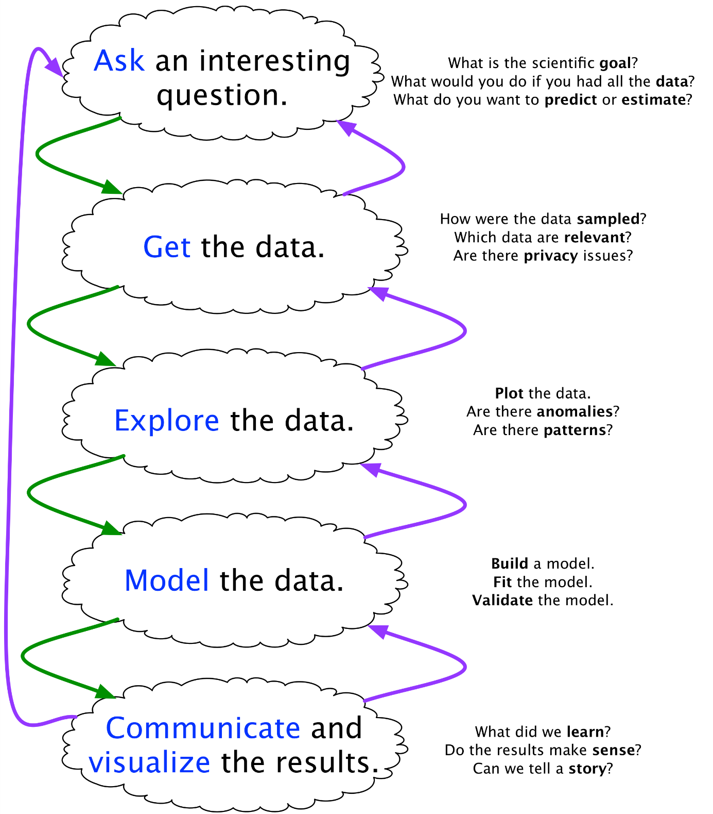
[Joe Blitzstein and Hanspeter Pfister, http://cs109.org]
Data science is a team activity, with subject matter experts.
Ethical considerations are paramount, and need not be in conflict with profitability.
Let the data speak.
Look for actionable insights!
Supervised vs. unsupervised.
Large proportion of analysis time spent on data preparation.

Slide 53
References
ISSUES AND CHALLENGES

Slide 54
References
Aggarwal, C.C. (ed.) [2015], Data Classification: Algorithms and Applications, CRC Press.
Aggarwal, C.C., Reddy, C.K. (eds.) [2014], Data Custering: Algorithms and Applications, CRC Press.
Torgo, L. [2017], Data Mining with R: Learning with Case Studies (2nd ed.), CRC Press
McCallum, Q.E. [2013], Bad Data Handbook, O’Reilly.
Maheshwari, A.K. [2015], Business Intelligence and Data Mining, Business Expert Press.
Provost, F., Fawcett, T. [2013], Data Science for Business, O'Reilly.
Frank, E., Witten, I.H. [2005], Data Mining: Practical Machine Learning Tools and Techniques, 2nd ed., Elsevier.

Slide 55
References
https://hbr.org/2013/07/how-google-flu-trends-is-getting-to-the-bottom
9 types of research bias and how to avoid them
Wikipedia entry for Bias: https://en.wikipedia.org/wiki/Bias
Wikipedia entry for Selection Bias: https://en.wikipedia.org/wiki/Selection_bias
Assessing Risk of Bias in Included Studies, Cochrane Methods
Data Snooping Bias, Quantshare
Wikipedia entry for Statistical Biases: https://en.wikipedia.org/wiki/Bias_(statistics)
Wikipedia entry for Benford's Law: https://en.wikipedia.org/wiki/Benford%27s_law

Slide 56
References
Silver, N. [2012], The Signal and the Noise: Why So Many Predictions Fail – But Some Don't, Penguin Press, New York
Lewis, M. [2003], Moneyball: The Art of Winning an Unfair Game, Norton, New York
Uri Simonshon, http://opim.wharton.upenn.edu/~uws/
https://en.wikipedia.org/wiki/Data_analysis_techniques_for_fraud_detection
Flaherty, D., “The Vaccine-Autism Connection: A Public Health Crisis Caused by Unethical Medical Practices and Fraudulent Science," Ann Pharmacother, Oct2011 v45 n10 1302-04
Reinhart, A., Statistics Done Wrong

Slide 57
References
https://www.datacamp.com/community/blog/data-science-past-present-future
Kargupta, H., Han, J., Yu, P.S., Motwani, R., Kumar, V. (eds) [2009], Next Generation of Data Mining, CRC/Chapman & Hall.

